Slide 1
John Harris in Holt Co. Missouri
Are we having fun yet?

Slide 2
John HARRIS and his wife ALLIS (possibly LIGGITT)
Questions:
  Where were they born?
  Who were their parents?
  When and where were they married?
  When and where did they die?
  Where were they buried?
  FOCUS ON ONE QUESTION AT A TIME
Notes:
FOCUS on one question at a time.

Slide 3
Create Family Group Sheet
John Harris
b. ca 1785 Virginia (Tennessee?)
son of
d. sometime after 1850 census
married before 1850
Allis (possibly Ligget)
b. ca 1795 Virginia
dau of
d.
Children
Jonathan Preston Harris b. 1822 Howard Co., Missouri d. 1892 New Market, Taylor Co. Iowa. Married 28 August 1844, Clinton Co., Missouri Sumyramus Burnham b. 1 Feb. 183 Howard Co., Misouri d. 1 June 1901 Taylor Co., Iowa
Thomas Harris…

Slide 4
Create Chronology
JohnHarris
Born abt 1784 based on 1850 census
Born in Virginia based on 1850 census, although two of his children say he was born in Tennessee
1810: Found a potential John HARRIS in the 1810 Reconstructed Census of Louisiana and Missouri Territory, town of Louisiana in Pike County, Missouri
1822: First child Jonathan Preston Harris was born in Howard County, Missouri
1825: Second child was also born in Howard County, Missouri
1829: Third child born in Missouri, but don’t know the county
1830: Census in Clay County, Missouri
1840: Census in Clinton County, Missouri…

Slide 5

Analyze what you know

Slide 6
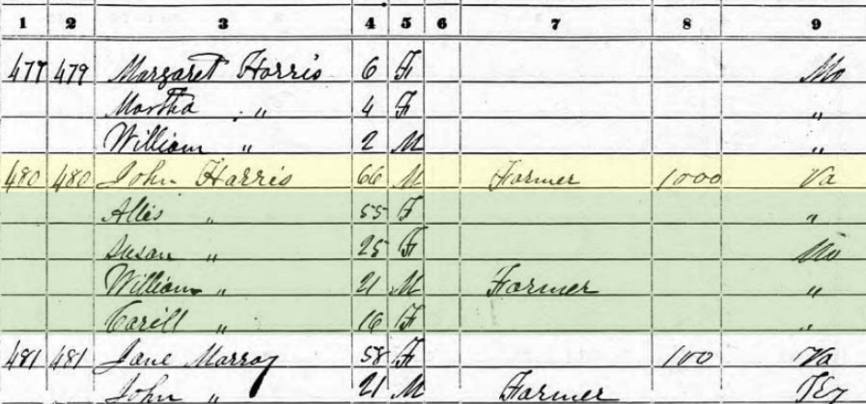
Start with what you know
Holt Co., Missouri 1850

Slide 7
1850 census
District 38, Holt Co. Missouri
John Harris 66 farmer, $1000 b. VA
Allis 55 b. VA
Susan 25, William 21,farmer, Carril 16
all b. MO
family enumerated next to
John P. Harris 28, farmer, $1000, Samirus 27,
Margaret 6, Martha 4, William 2 all in hh b. MO

Slide 8
What we know from 1850 Census
John Harris b. ca 1784 in Virginia. ( died between 1850-abt. 1884)
Allis is probably his wife; she b. ca 1795 in Virginia
His oldest known child, Jonathan P. was b. ca 1822 in Missouri. John would have been 38 then; Allis 27.
John (and Allis?) were in Missouri as early as 1822; Jonathan P. born there.
If Allis Jonathan’s mother, John & Allis married before 1822.
John purchased land in Holt County before the 1850 census
John is a farmer
John (and Allis?) likely parents of Susan b. 1825, William b. 1828 and Carril b. 1834.
  (Note the 6 year gap between birth of Wm & Carril; awhispering hint that Allis may be only the mother of the youngest child) Allis would have been about 39 when Carril born.

Slide 9
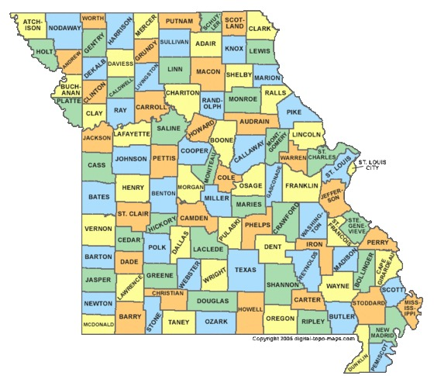
Where is current Holt County, Missouri ?
Notes:
Wiki

Slide 10
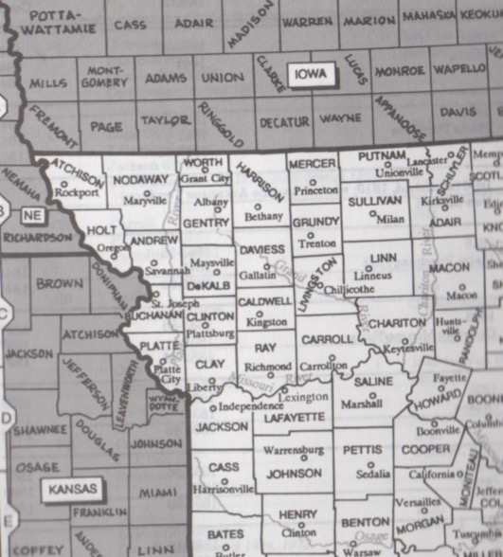
What is it near?
Notes:
Redbook

Slide 11
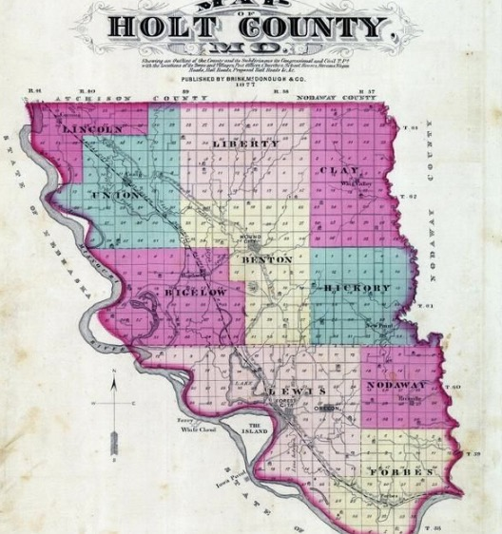
Where were they in Holt Co.?
Townships in Holt Co. 1877
Notes:
Google Holt Co. MO, then look at images

Slide 12
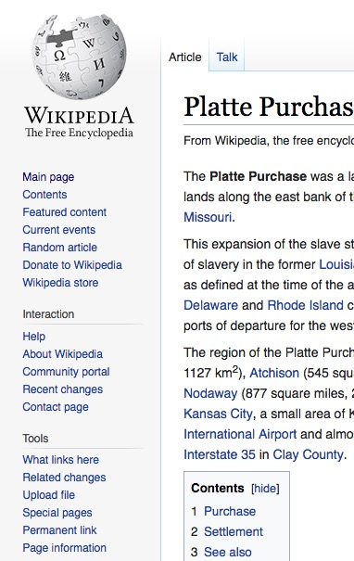
When was Holt Co. formed?
And from what county?
Formed 1841
From Platte Purchase
(-- but map shows that area part of Buchanan Co. in 1840. Buchanan formed 1838 as Roberts, renamed Buchanan in 1839.)

Slide 13
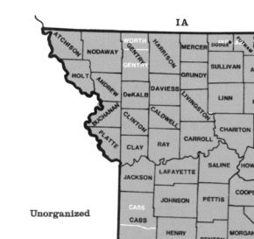
NW Corner Missouri in 1850
Notes:
Holt surrounded by Atcheson, Nordaway,

Slide 14
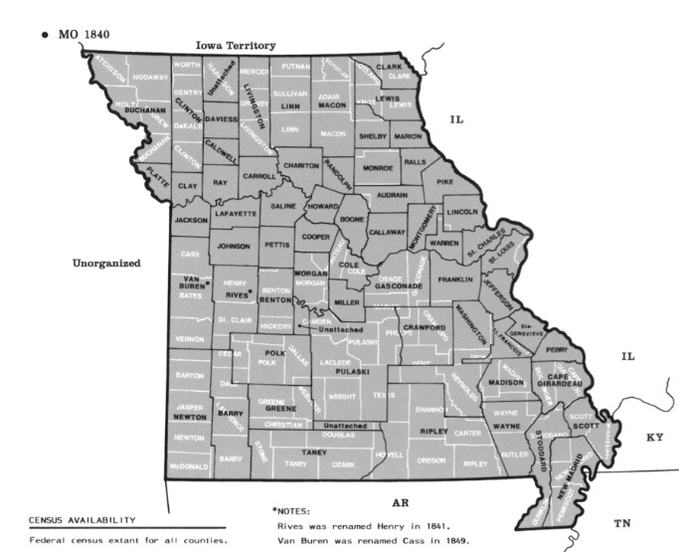
Missouri 1840
Notes:
Holt is in the area then called Buchannan Co.

Slide 15
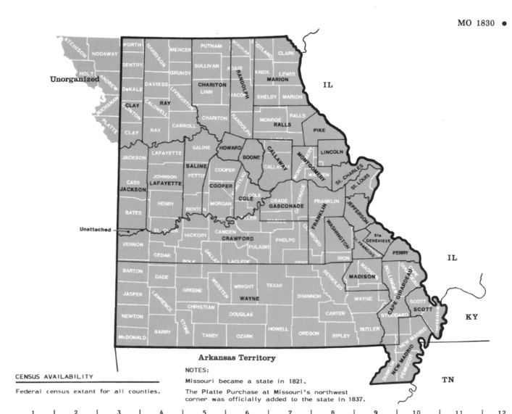
Missouri 1830

Slide 16
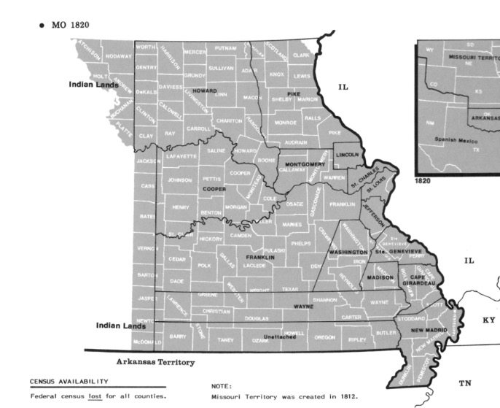
Missouri 1820
Notes:
Notice that if oldest son b. Howard Co. in 1822, it could be a large area.

Slide 17
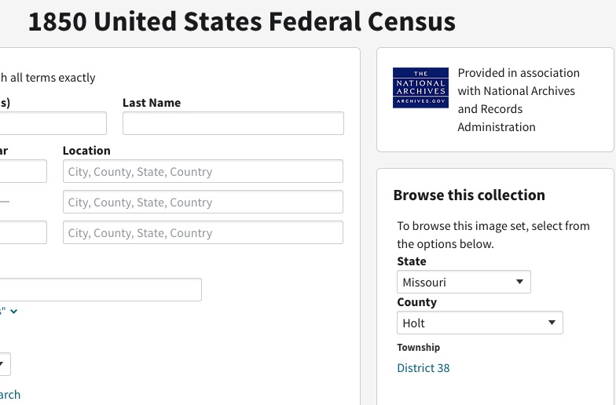
In 1850 they were in District 38 of Holt Co. – where is that?
Notes:
We don’t know where in the county they were– what township.

Slide 18
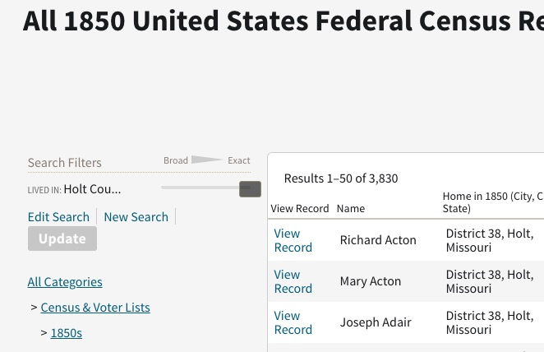
How populated was Holt Co.?
Notes:
3, 830 individuals enumerated.
Fewer households <1000
fewer sunames
Even fewer related families

Slide 19
Questions based on 1850 Census
Where is reputed son Thomas, b. abt. 1825
  What evidence that Thomas is a son?
When did John and Jonathan purchase the land they owned in 1850? And where was it?
What other Harris surnames do we find in Holt Co. in 1850?
Who are neighbors, where born? ( Esp. those owning land. )

Slide 20
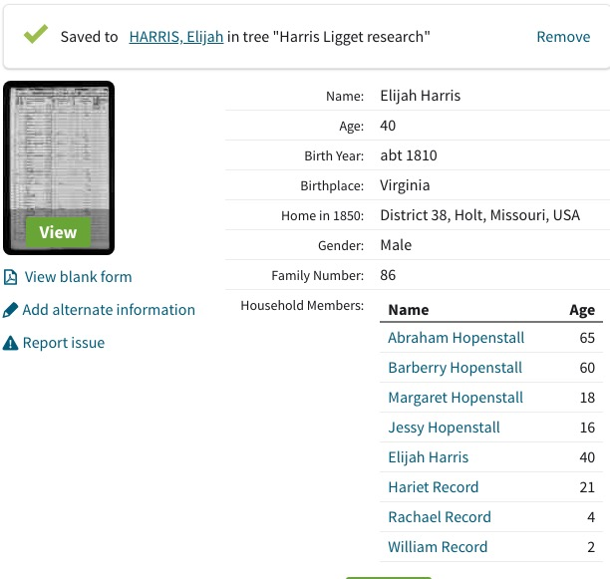
Elijah Harris b. 1810 VA
Notes:
When did the Happenstalls arrive and where was their land?

Slide 21
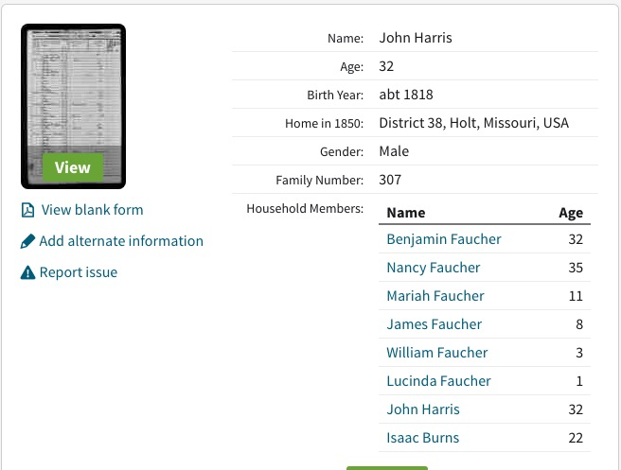
John Harris b. 1818 (bp not given)
Notes:
He doesn’t own land. When did Benjamin Faucher arrive, from where and where was his land?

Slide 22
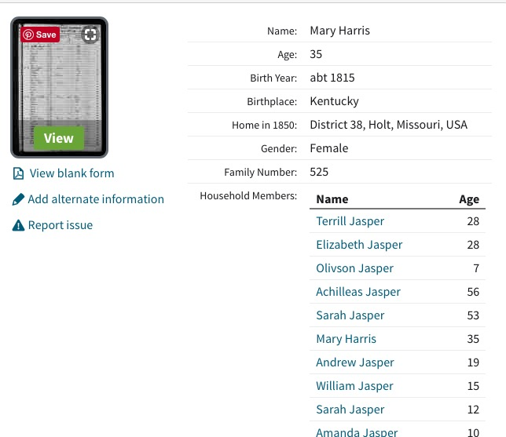
Mary Harris

Slide 23
Possible Harris connections based on 1850 Census (family#480)
Elijah Harris, b. 1810 VA who is living with Happenstall family in 1850 (family # 86)
Mary Harris b. 1815 KY, who is living with Jasper family in 1850 (family#525)
John Harris b. 1818 who is living with Faucher family in 1850 (family#307)
Families of neighbors: John Norvill b. 1811 Tenn, $1300, John Brammell b. 1810 VA $1000, James Whitten b. 1790 VA, Meth Minister, Willis Brockman b. 1800 VA $2000…
Notes:
FAN PRINCIPLE

Slide 24
Where can we find evidence of death?
Census records
Death Record
Burial
Church Records
Probate
Land Records
Obituaries (Newspaper records)
Pension records
Family Bible Records
Family History Records
  Biographical information on children, grandchildren

Slide 25
Census Records
1860 Population Census
  John Harris is not in Holt Co., nor is Allis or Carrill. The 3 older children have married and remain.
  Haven’t found a John Harris, Alice Harris or Carrill Harris in 1860 (that doesn’t mean they aren’t there somewhere)
1860 Mortality Schedule
  Found no matching deaths for 1859-60
Notes:
This SUGGESTS he (and Alice) may have died before 1860. If so, we might expect to find a probate of his estate since we know he owned property.

Slide 26
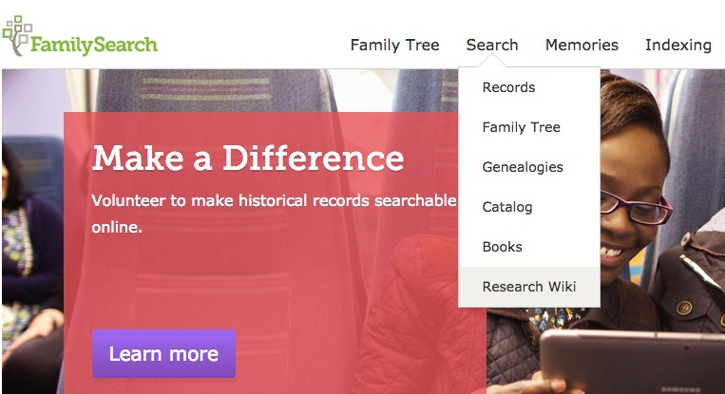
What death records exist 1850-1884?

Slide 27
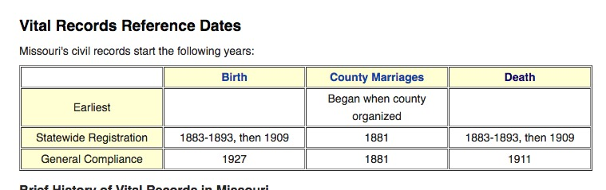
Vital Records in Missouri

Slide 28
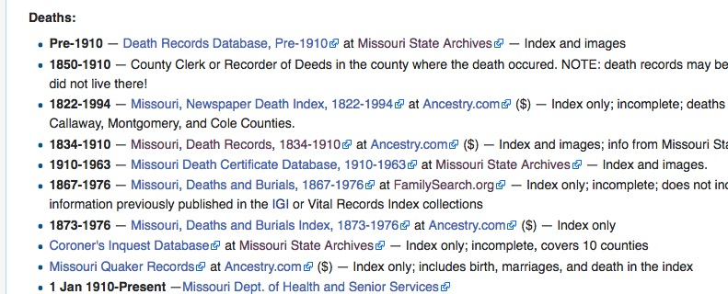
MO Death Records online
(from FS Wiki)

Slide 29
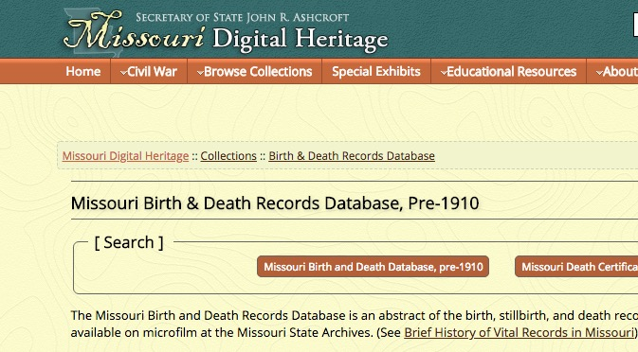
Some earlier records

Slide 30
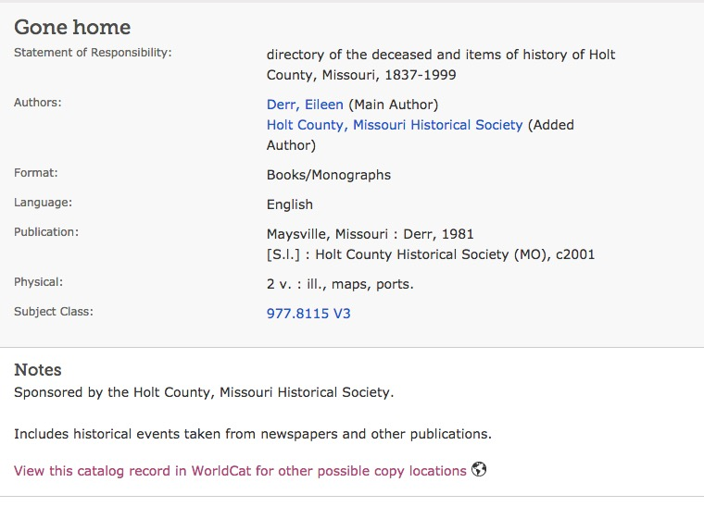
Burial Records—if not found online, check for published records. FHL.
This was not filmed
No digital version
online
Notice who published
This.

Slide 31
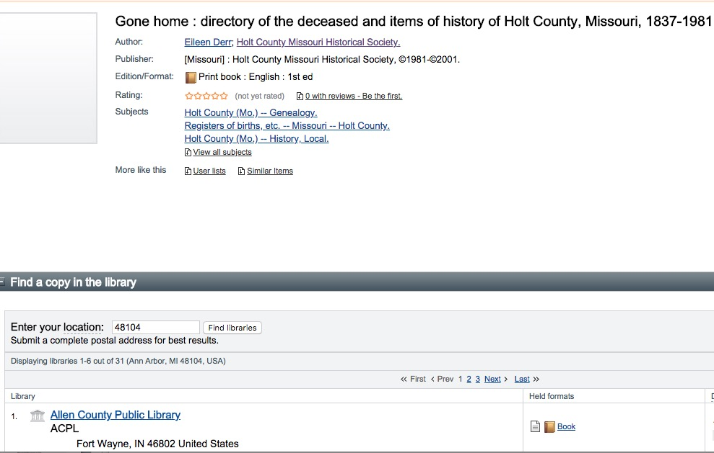
Use WorldCat to find out nearest owning library
Notice this was put
Out by Holt Co. Hist Soc.

Slide 32
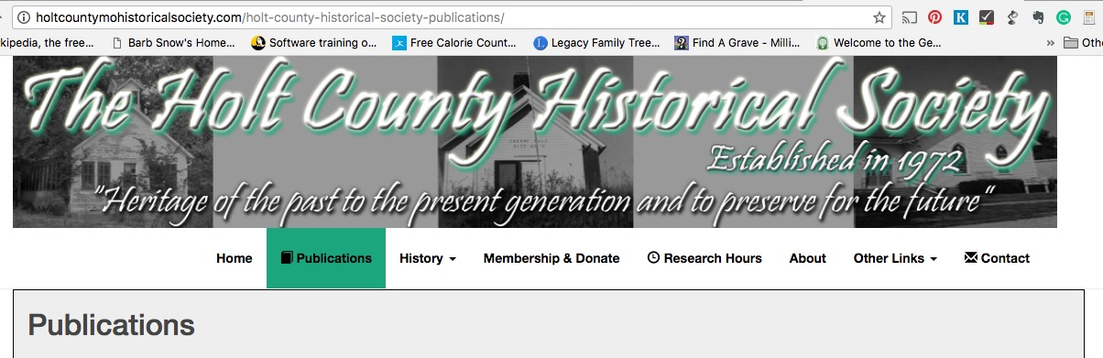
Notice this was put out by the Holt Co. Missouri Historical Society
Notes:
They will do research

Slide 33
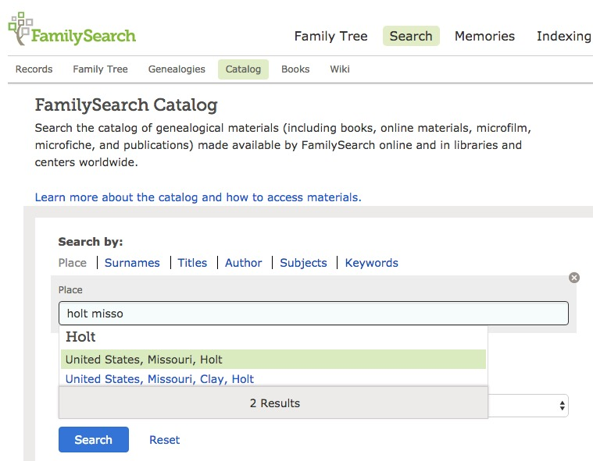
Search FHL Cat for Holt Co.
Probate Records

Slide 34
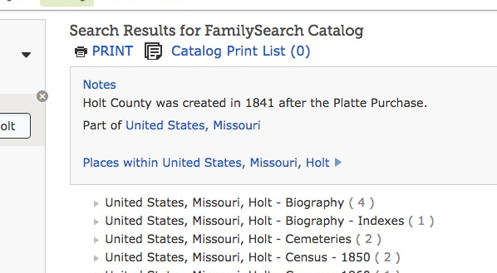
Are probate records for Holt Co. available?
Notes:
SEARCH HOLT MISSOURI

Slide 35
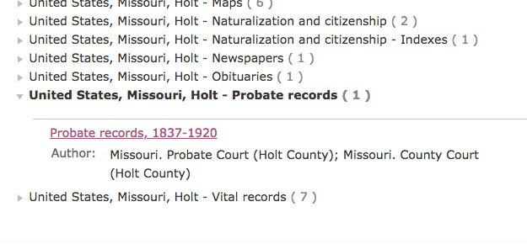
Yes!
Probate Records have been filmed

Slide 36
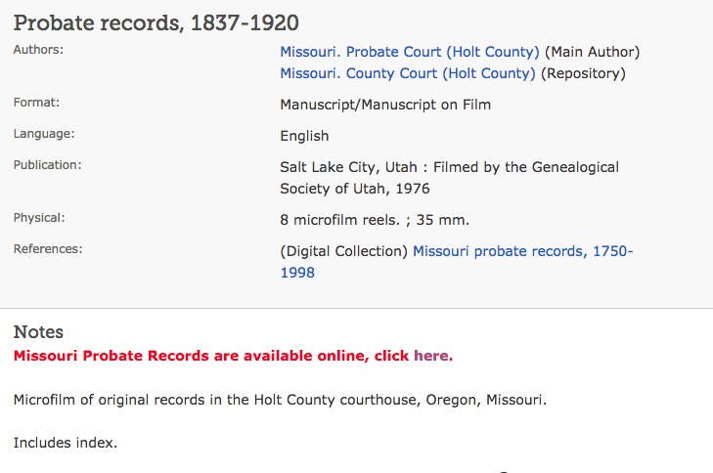
Here is the cat record – note these are available online (unindexed)

Slide 37
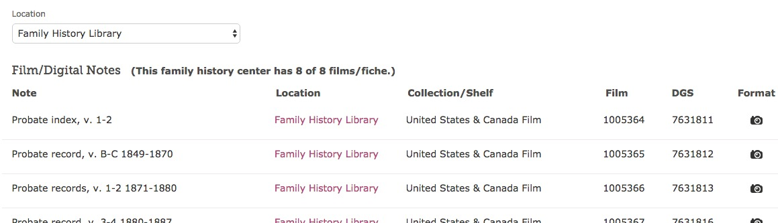
Scroll down for listing by item
Want to check the index
Click the camera to
go straight to the film
you want to see.

Slide 38
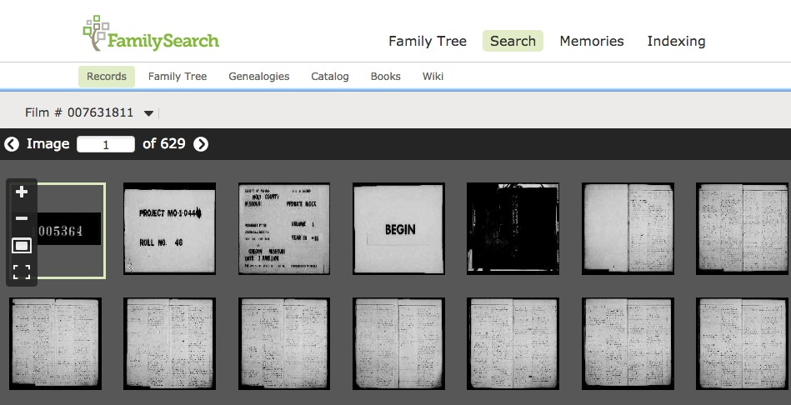
Digital version of the film

Slide 39
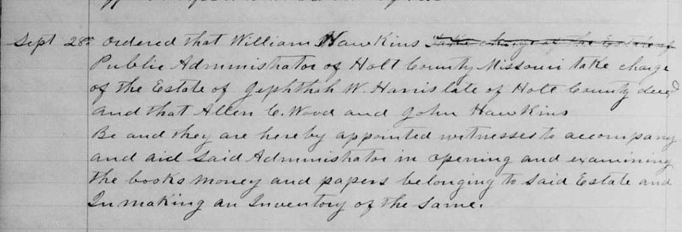
Jeptha Harris 1878

Slide 40
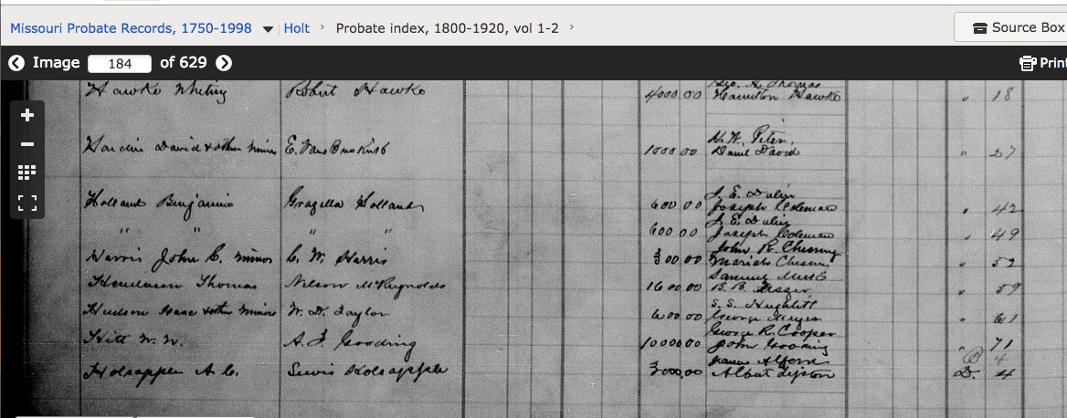
John C. Harris
Notes:
John C. Harris

Slide 41
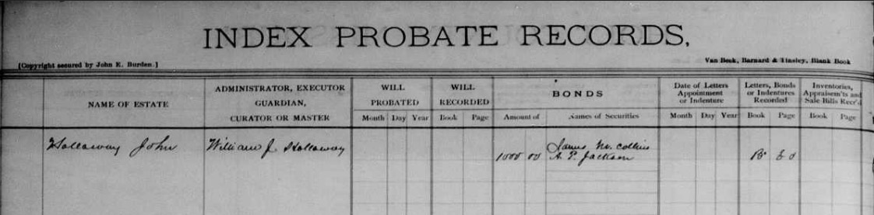
Go to top of page to see what the columns mean

Slide 42
What have we learned
John, Allis, Carril Harris, ages 76, 65 and 35 not found in census records. (Carrill may have married).
No death record found in mortality
No official death record likely to exist
Have to check cemetery book when at Ft. Wayne
No probate record found for John Harris
But we know he owned land. What happened to that? It is time to look at land records….

Slide 43
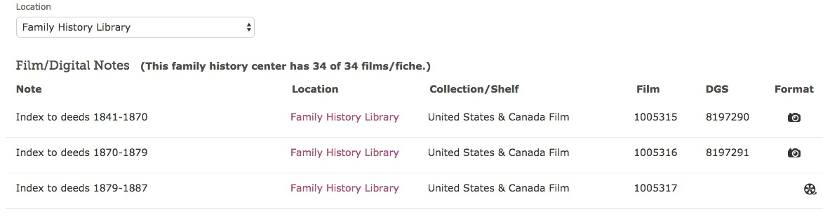
Family Search as filmed Holt Co. land records; some online

Slide 44
Index 1841- 1870
Grantor – buyer
Grantee – seller
Found a record for John Harris & w selling land in 1851 to his future son in law John Norvell

Slide 45
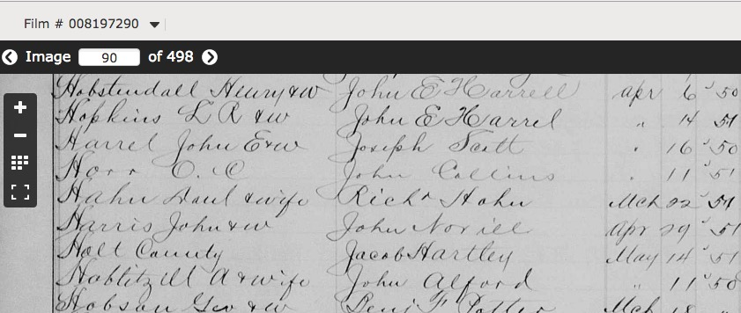
Grantor Index

Slide 46
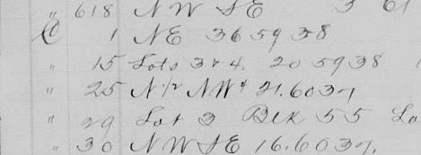
Vol. C is not online; will have to get record from courthouse.
Was this all the land he owned?

Slide 47
Grantee Index
No record of him purchasing land; where did he get the land he owned in 1850, sold in 1851?
And did he sell all of the land he owned?
If not, what happened to it?
  I only checked grantor index through 1870
Notes:
His wife may have inherited it.
He may have been a first purchaser

Slide 48
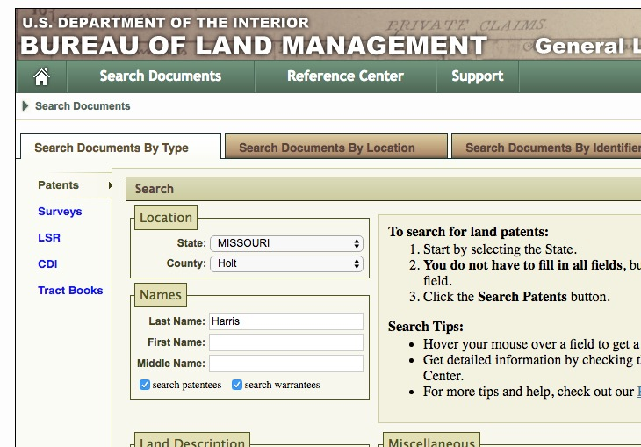
https://glorecords.blm.gov

Slide 49
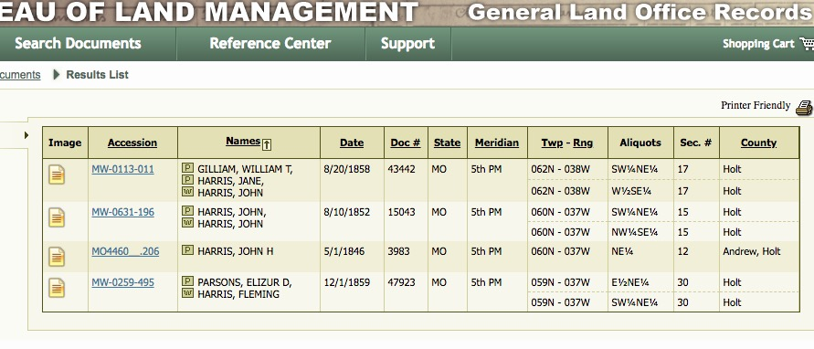

Slide 52
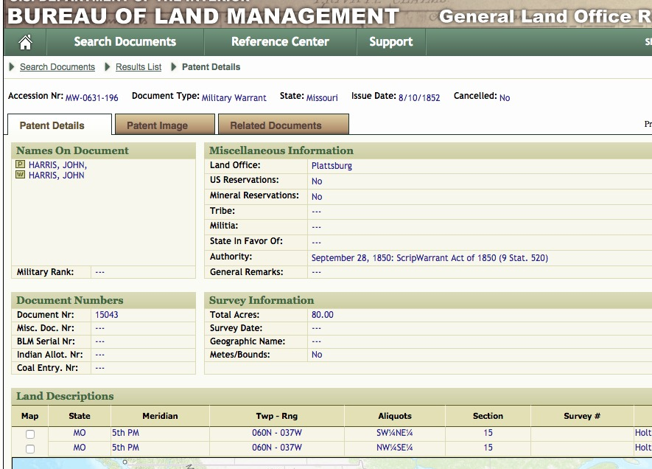
Patent Details land in Section 15 of Twp. 60 N 37 W

Slide 53
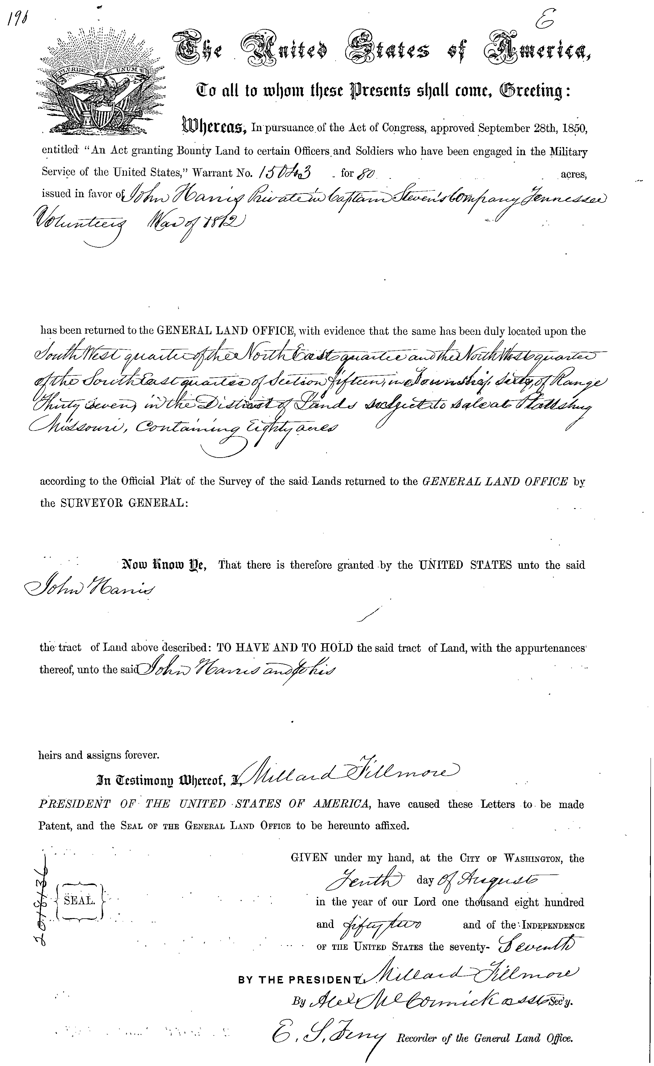
John Harris Private Capt. Stevens Co., Tennessee Volunteers War 1812
Notes:
This is the patent

Slide 54
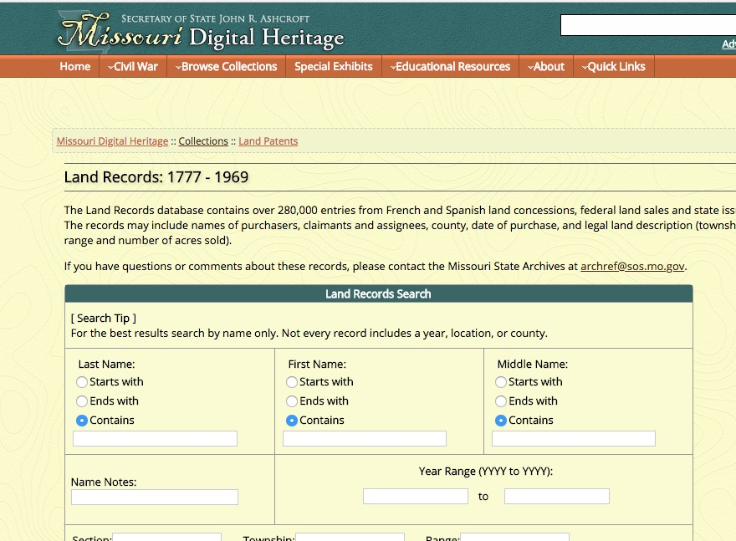
Missouri Digital Heritage
Land Record Database

Slide 55
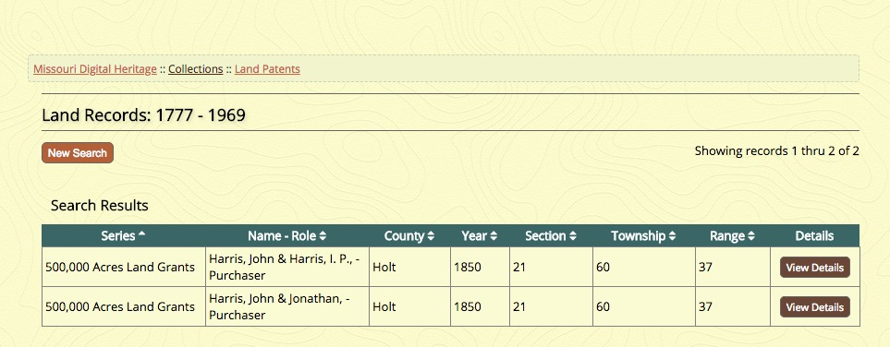
Original Purchase of Land
John & J.P Harris

Slide 57
Land ownership John & J.P. Harris Twp. 60 Range 37
180 Acres in Section 15 (Fed)
  SW ¼ NE1/4 and NW ¼ of SE 1/4
80 Acres in Section 21 (State)
  NW ¼ and SE ¼

Slide 58
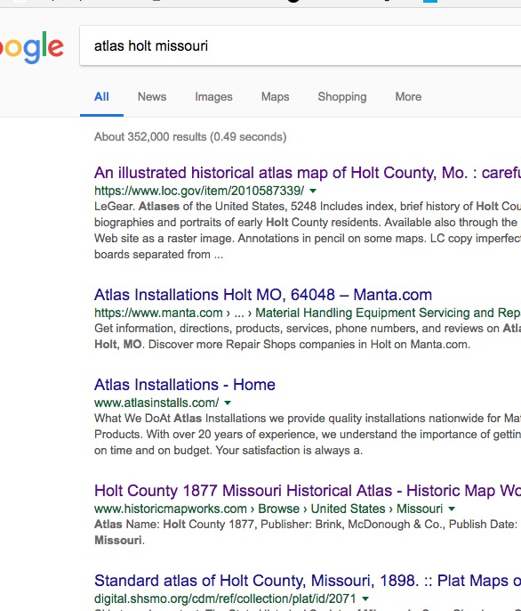
Google Atlas Holt Missouri… there are lots of old atlases online

Slide 59
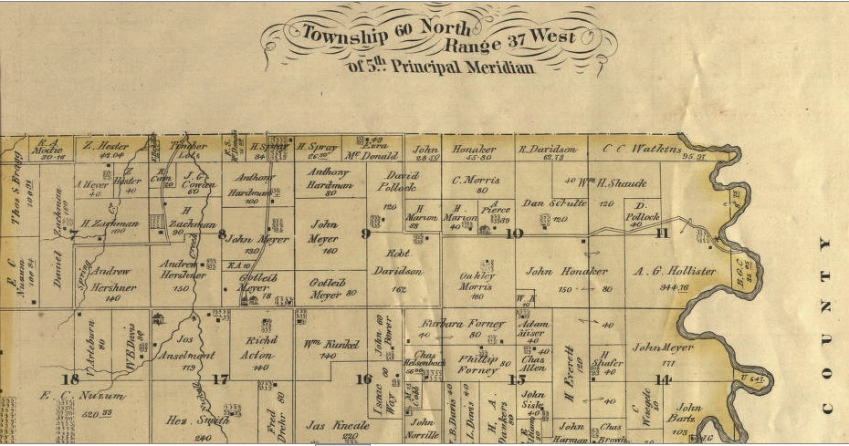
Twp. 60 N 37 W (1877)

Slide 60
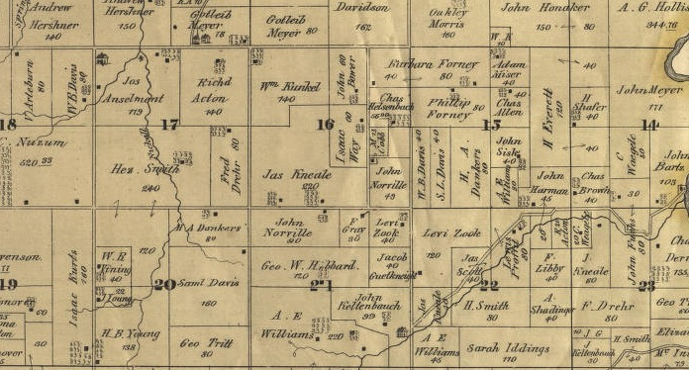
Section 15 and 20
Notes:
Now we know who owned the land in 1877 or 78, we can better use land records.
Shall I do a section on land research

Slide 61
1840 Census
1 M 50 – 59 = b. 1780-1790 John b. 1784
1 F 40 - 49 = b. 1790-1800 Allis b. 1795
-------------
1 F 5-9 = b. 1830-1835 Carill b. 1834
1 M 10 -14 = b. 1825-30 William H. b. 1829
1 M 15 -19 = b. b. 1820-1825 J.P. b. 1822
1 F 15 thru 19 = b. 1820-1825 Sophronia b. 1825
1 F 20 thru 29 = b. 1810-1820 might this be the Mary Harris b. 1815 KY?
Notes:
Nice Match

Slide 62
1830 census Clay Co., Mo.
John Harris – the same?
1 M 30-39 = b. 1790-1800 (John b. 1785)
1 F 20-29 = b. 1800-1810 (Allis b. 1795)
1 M <5 =b. 1825-30 (William H. b. 1829)
1 F < 5 = b. 1825-1830 (Sophronia b. 1825)
1 M 5 -9 = b. 1820-25 (J.P. b. 1822)
1 F 10 -14 =b. 1815-1820 (Mary??)
What do we make of the this one?

